Slide 1
Phi Theta Kappa Honor Society Beta Beta Epsilon Chapter Accomplishments Great Basin College 2022 – 2023
Co-Advisors:
Professor Lynette Macfarlan & Instructor Jennifer Stieger

Slide 2
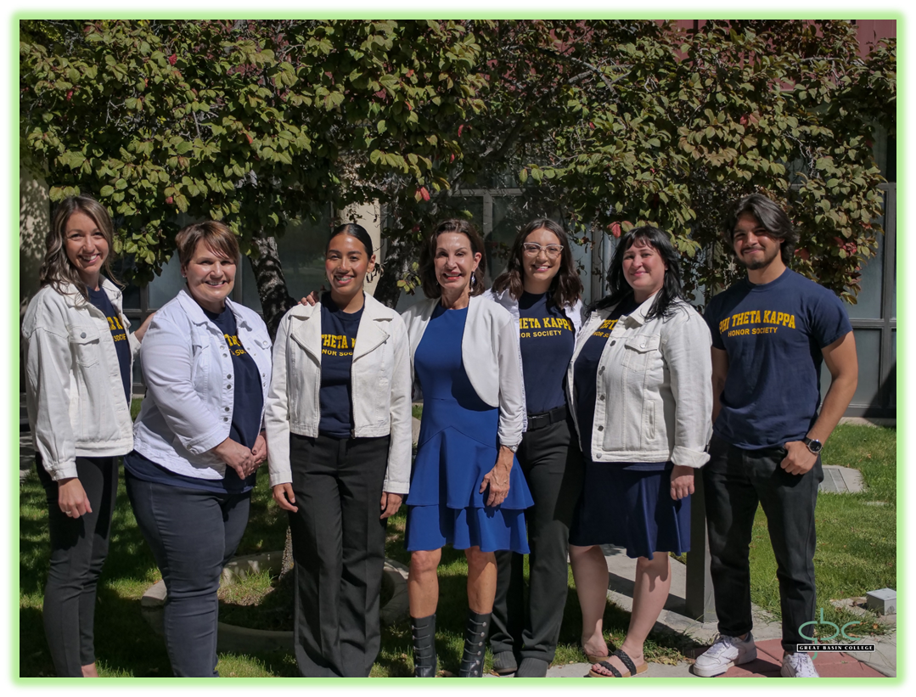
Beta Beta Epsilon Officer Team
Phi Theta Kappa Mission: The mission of Phi Theta Kappa is to recognize academic achievement of college students and to provide opportunities for them to grow as scholars and leaders.

Slide 3
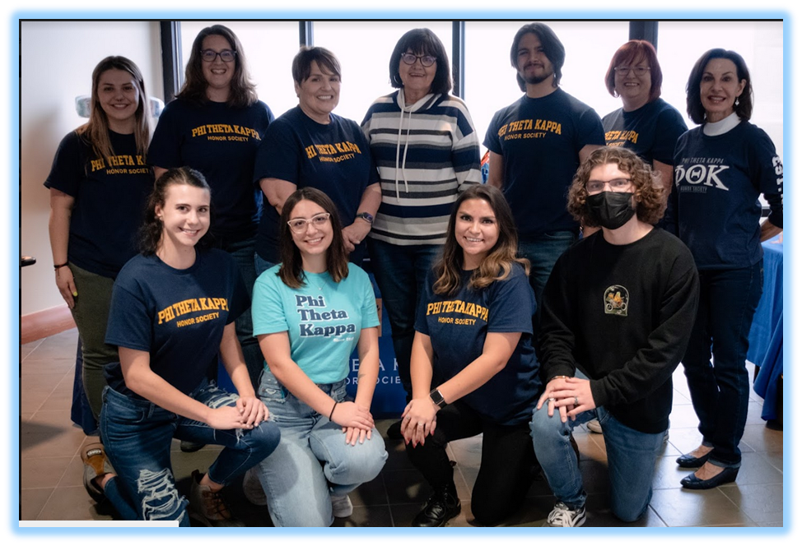
Beta Beta Epsilon Officer Team
“You Matter Foster Child Campaign” Luncheon & Social
Beta Beta Epsilon Members & Officers with Regent, Cathie McAdoo

Slide 4
Nevada/California Accomplishments, Pomona, California From 2020 One–Star Status to 2023 Five-Star Status
Distinguished Officer Team Award
Five Star Status, Regionally & Nationally

Slide 5
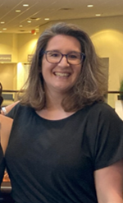
Distinguished Team, HIA, Advisor & Edge Training Awards Honors in Action: 1st Place Action Research Award, “The Nostalgia of Play” Supported by Co-Advisor, Jennifer Stieger Regional Conference, Pomona, California

Slide 6
Accomplishments ~ 2022-2023
“Board of Regents Phi Theta Kappa Presentation” – In the fall of 2022, the PTK Officers presented to 13 Regents and 8 College Presidents focusing on community service initiatives aligned with the GBC mission, Core Theme 2: Build bridges and create partnerships with entities external to GBC as appropriate to fulfill the GBC mission. The presentation highlighted successful food drives in 2021 – 2022 during a pandemic and the “You Matter Foster Child Campaign” which was launched in September of 2022.
“Presentation to GBC Foundation” – The PTK officers and members shared their altruistic food drive accomplishments with the trustees, and highlighted the up-coming event, “You Matter Foster Child Campaign. In addition, the student requested funding to attend regional & national PTK conferences. The foundation granted the students $6,000.00 which was double by a private citizen match of $6,000.00. This enabled the students to attend both the PTK NV/CA Regional Conference March and the PTK National Conference in April.
“You Matter Foster Child Campaign” – The PTK students partnered with the Rural NV Division of Child & Family Services, Nye County Division of Child & Family Services, CASA, GBC Student Government Association, Lakeshore Learning Materials, Nevada Early Intervention, GBC Social Work Program, GBC Classified Staff, and Nevada Gold Mines.

Slide 7
Accomplishments ~ 2022-2023
“You Matter Foster Child Campaign” – Continued: Due to gratuitous giving in five communities, Battle Mountain, Elko, Pahrump, Ely, and Winnemucca, over 400 foster children in transition from home to foster care received brand-new essential items: Total “You Matter” Bags Donated Campus-Wide: 551; Total Diaper Donations: 7,500; Total Cash Donations: $450.00; Total Items to Include Miscellaneous Donations: 12,100, and Total Gift Card Donations for Teens: $3,485.00. The to-bags, diapers, gift cards, and additional items were delivered to the Rural Division of Child & Family Services in four communities on November 16, 2022.
“Eric Litwin, International Children’s Author & Performing Artist” – The Beta Beta Epsilon students exercised their leadership skills by organizing a children’s concert at the Elko Convention Center in March of 2023. The event was a huge success with 750 children and their families in attendance. Nevada Gold Mines, Children Cabinet, and the Elko County Early Childhood Advisory Council provided funding for the event. Ten non-profit organizations provided free literacy materials and storybooks for all children in attendance.
“PTK Regional Conference, Cal Poly State, Pomona, California” – Three Beta Beta Epsilon students and their advisor, Lynette Macfarlan, attended the first regional PTK conference in GBC history. The students received an award for Five-Star status, the New Advisor Paragon Award, the Most Distinguished Officer Team in the Region, Edge Leadership Training Recognition, and 1st place for their Honors in Action Research Project, “The Nostalgia of Play.”

Slide 8
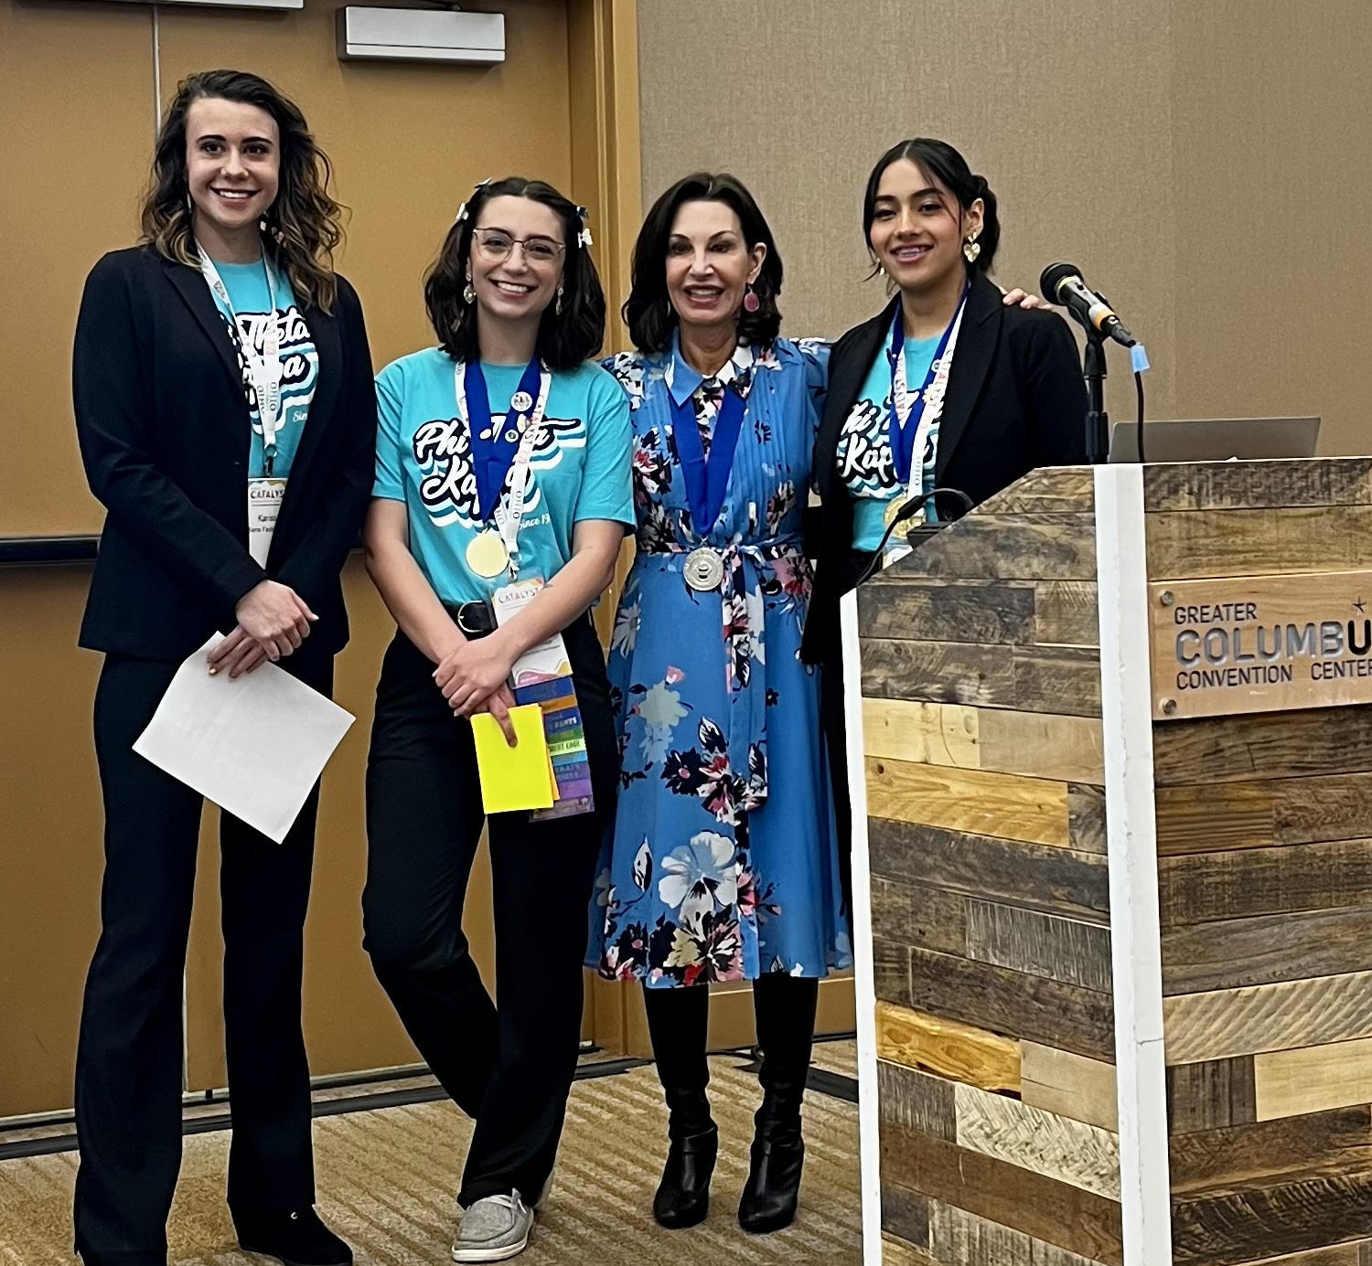
National Catalyst PTK Accomplishments Columbus, Ohio ~ April 2023

Slide 9
Accomplishments ~ 2022-2023
“PTK National/International Conference” – Four Beta Beta Epsilon Students and two advisors attended, for the first time in GBC history, the Catalyst Conference in Columbus, Ohio in April 2023. The Beta Beta Epsilon students were selected as 1 out of 10 chapters to present their college project, “The You Matter Foster Child Campaign” at a national forum. They shared the stage with Utah Valley College.
During the conference, the students won the following international awards.
National PTK New Advisor Paragon Award: Lynette Macfarlan
National PTK Distinguished Officer Team Award: PTK 2022 – 2023 Officers: Yadira Carlos, Maddison Mead, Cindy Holt, Sandro Gamarra, Sarah Crews, and Amanda Halsey
National Student Recognition for organizing college projects that focus on community partnerships with state, national, and global impact

